Slide 1

Rain Gauge sensor package
ARTS Lab Weekly Update
Ryan Brown

Slide 2
Ordered Pcb
Ordered the PCB last week
Waiting to receive the PCB to run initial tests before putting into emvirnoment

Slide 3
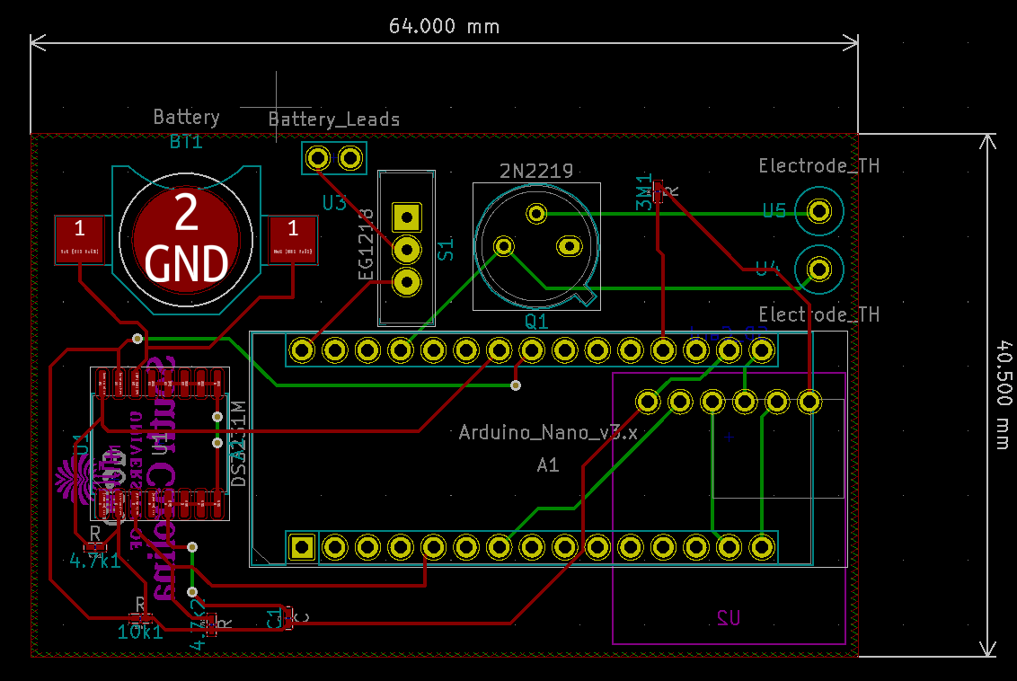

Slide 4
Package
Working on redesigning the nozzle to accommodate a smaller exit tube
Working on small prototype board, having some issues getting the SD Card module to respond to the arduino

Slide 5
Thanks!

